Slide 1
CS Auburn / USDA Updates
🎃31 October 2024 👻

Slide 2
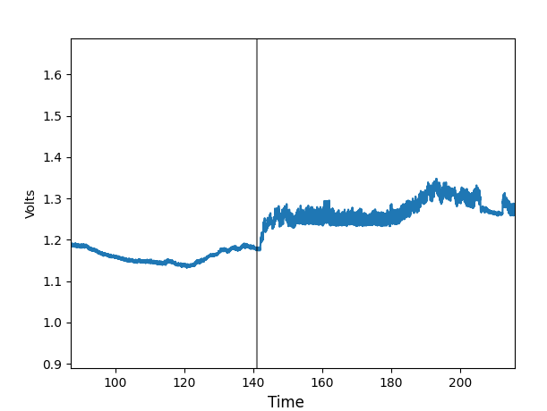
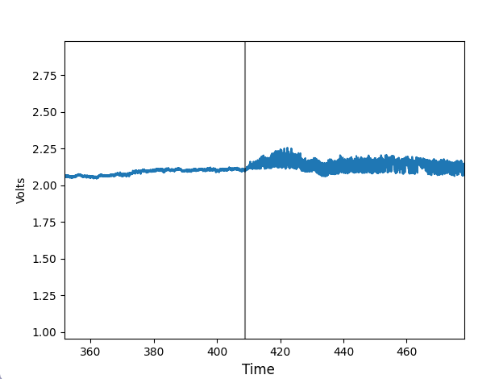
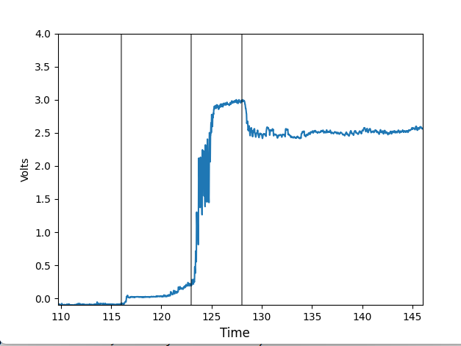
Change point detection (motivation)
Instead of labeling each individual second, we could instead just find where transitions occur and then label sections as a whole. This is closer to how people label waveforms.
Transitions are often associated with a change in either signal amplitude or mean.
If we can automatically find where these transitions occur, it could simplify the automatic labeling process.

Slide 3
Change point detection (background)
How do we do this?
For a given time segment of the waveform, we can calculate the mean and the standard deviation of the voltages within that time frame.
Mean: signal mean
Standard Deviation: Proportional to signal amplitude
Theoretically: We find the best places to subdivide the signal such that the data in each division best fit to a normal distribution with mean and standard deviation from that subdivision
Visually: Find the places where the signal jumps or the amplitude changes
Practically: We can just use the python library ruptures, which does that for us

Slide 4
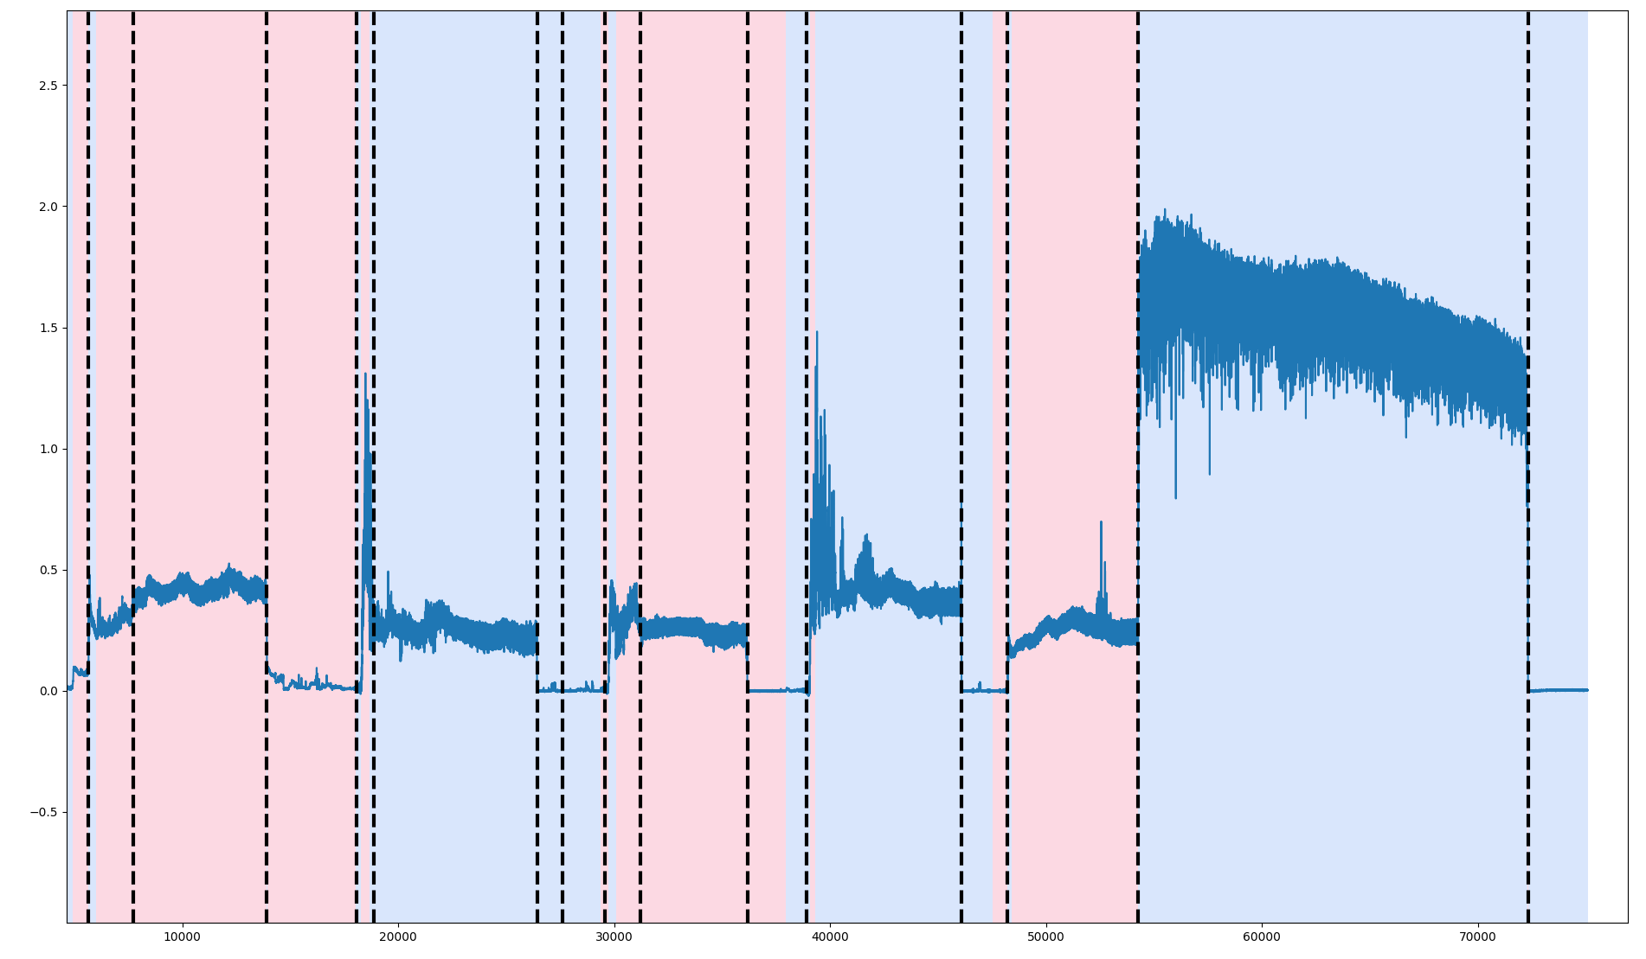
Change point detection (results)
In many cases, this algorithm finds transitions quite well (if properly tuned)
Any “extra” changes spotted aren’t necessarily a problem since the next step should be able to identify each side of the transition as being the same.

Slide 5
Change point detection (drawbacks)
Tuning: algorithm either requires knowing how many transitions happened ahead of time (or at least an upper bound) or using a tuning parameter that balances making sure segments are homogeneous with the number of segments.
Having an upper bound on the number of transitions can be achieved by first dividing each recording into different probes (which can be done fairly easily since we know that the signal goes back to baseline between each one)
We know that there are probably less than 10 or so transitions per probe
Tuning parameter is hard to set because the best one appears to be different for each waveform. This is probably because they each have different lengths and ranges of voltages.
When wrong, will miss mislabel large chunks of data

Slide 6
Change point detection (Advantages)
More akin to how humans would label these waveforms
Model mistakes are easily to understand by humans
Labeling between transitions could be an easier task than labeling short snippets because there is more data to make a decision based off of.

Slide 7
Change point detection (Next steps)
We currently have a model that can find transition points and then attempt to label between them
Accuracy is quite poor
This whole process can be considered a rudimentary version of a Gaussian Hidden Markov Model
Hidden Markov Model: Like changepoints but has better theoretical guarantees
This model will be our next focus, it also allows us to encode the transition matrix which should lead to better results.

